Slide 1
Games Bootcamp
Advanced Coding Concepts

Slide 2
Recap
Major Project Progress

Slide 3
Table of contents
01
OO-Programming
04
Coroutines
02
Events & Delegates
05
Debugging
03
Namespaces
Fundamentals of OOP
Timers & Delays
The Observer Pattern
Debugging tools
Organisation of code into libraries

Slide 4
01
OO Programming

Slide 5

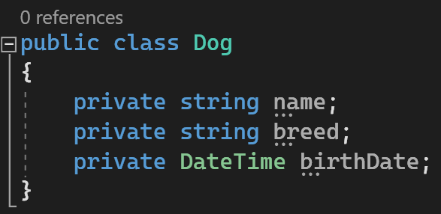
Object-Oriented Programming (1)
A coding paradigm that structures code as objects.
Each ‘object’ is a self contained piece of data and a set of actions that can be performed on that data.
They are models of real world objects, concepts or processes

Slide 6

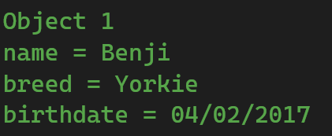

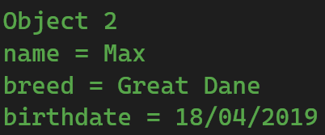
Object-Oriented Programming (2)
Classes are templates that can be replicated. Instances of these classes are ‘objects’ or ‘instances’

Slide 7
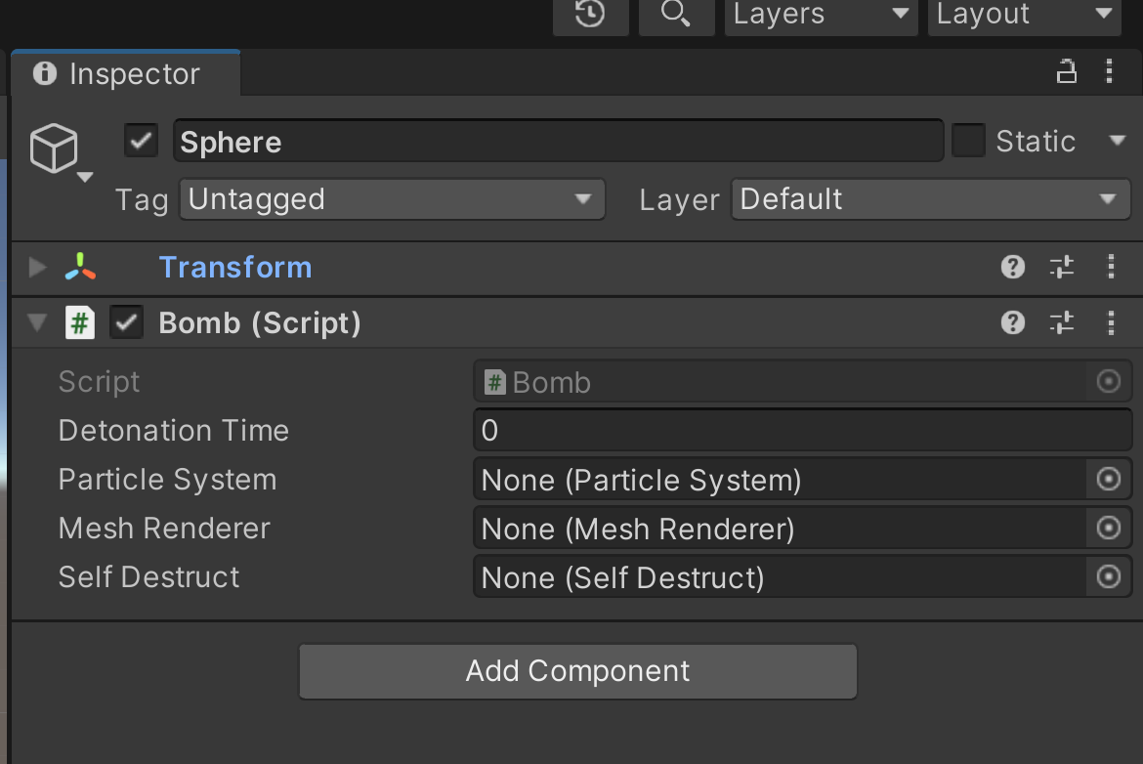
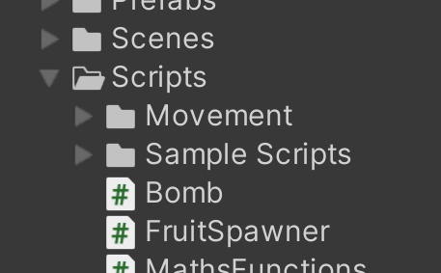
Object-Oriented Programming (3)

Slide 8
Object-Oriented Programming (4)
Key OO Concepts:
Abstraction | extracting essential properties & behaviours
Encapsulation | bundling this data and functions into a class
Inheritance | classes can ‘inherit’ properties and methods.
Polymorphism | functions with the same name can be reused

Slide 9
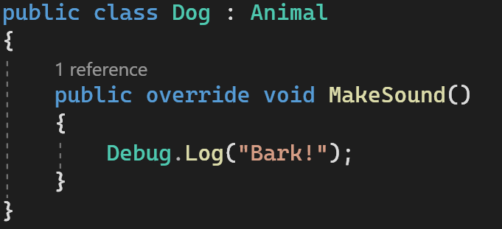
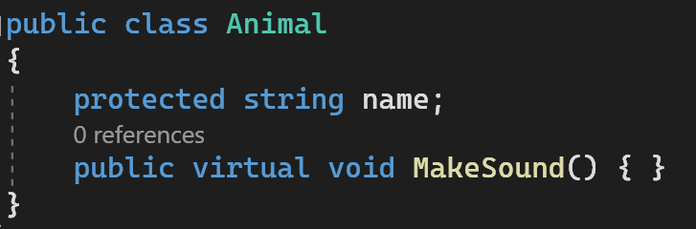
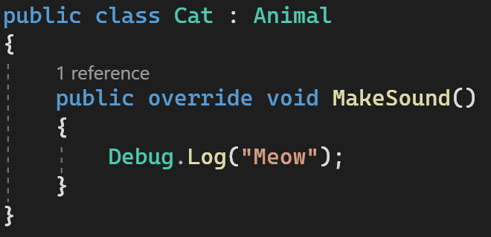
Object-Oriented Programming (4)
Inheritance & Polymorphism
Notes:
demonstrate.

Slide 10
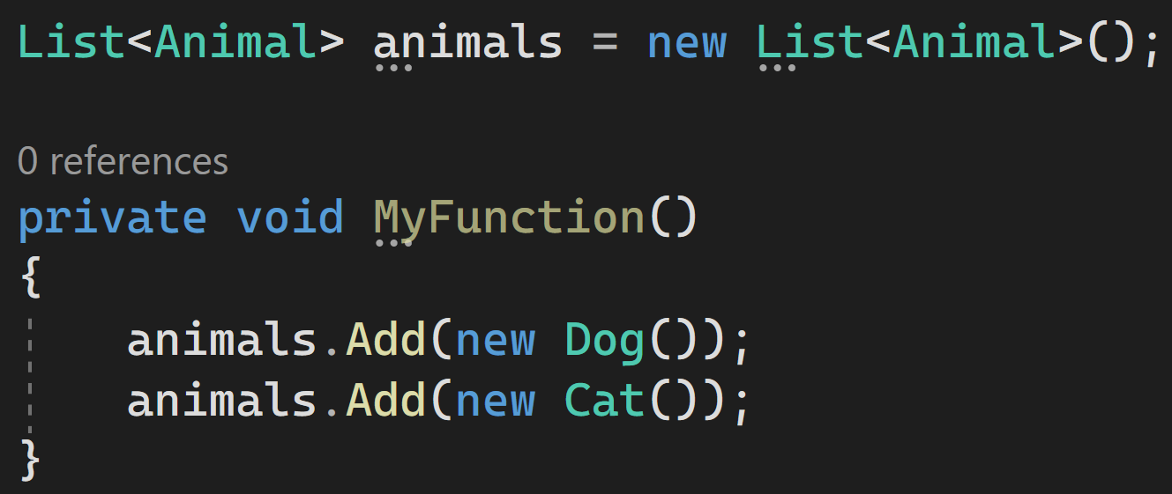
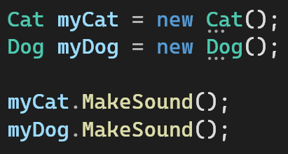
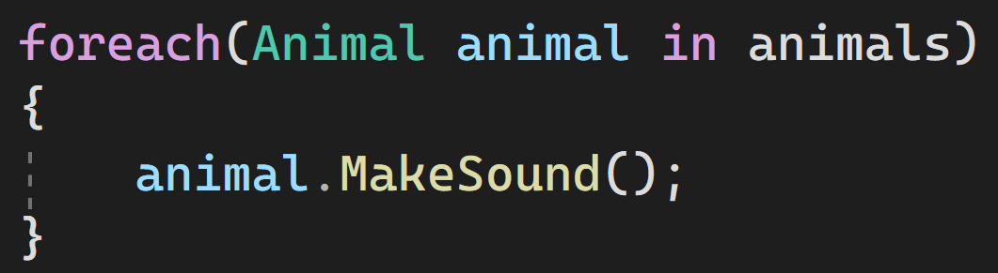
Object-Oriented Programming (5)
Inheritance & Polymorphism

Slide 11
02
Events & Delegates

Slide 12

Events & Delegates (1)
An action that broadcasts a message to other objects. OBSERVER PATTERN
Events have publishers and subscribers
If there are no subscribers the event is not raised
Update UI
Player Dead
Reset Game
Switch off Input

Slide 13


Events & Delegates (2)
Delegates are a C# feature.
They are a type that can reference functions with matching parameters and return types.
‘a person sent or authorized to represent others, in particular an elected representative sent to a conference’

Slide 14
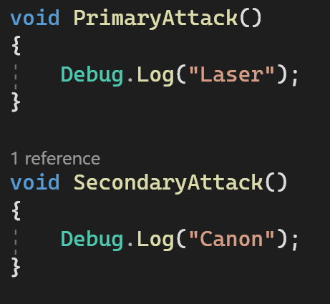
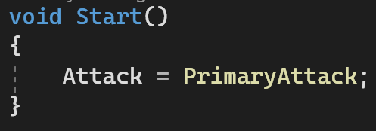
Events & Delegates (2)
We can now assign functions to the delegate instance.
They must match the signature

Slide 15
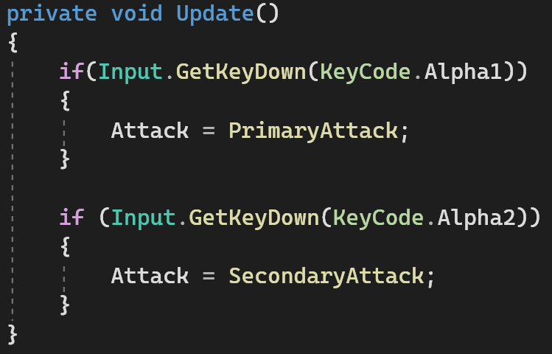
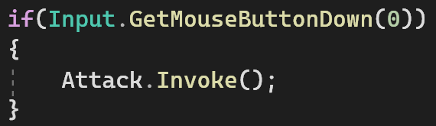
Events & Delegates (3)
Assignments can be changed at runtime.
You can use this to create things like a weapon system.
Switch Weapon
Execute

Slide 16

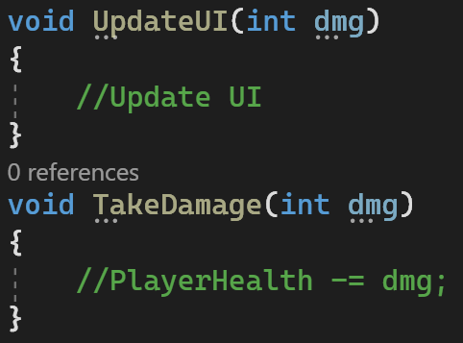
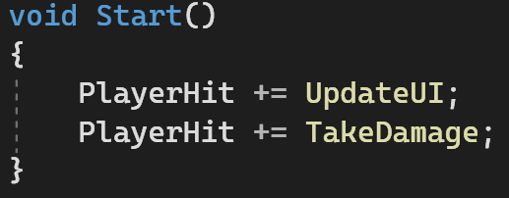

Events & Delegates (3)
Delegates support multicasting with ‘+=’

Slide 17
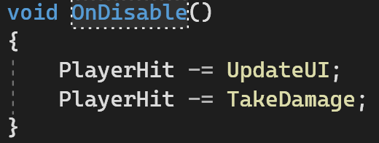
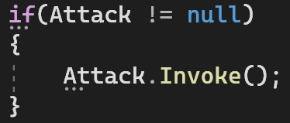

Events & Delegates (4)
All subscribers must unsubscribe before they are destroyed
If the object is destroyed you would be calling a function that doesn’t exist
Delegate instances can also be ‘null’ if not assigned. You should check this before Invoking a delegate or event.

Slide 18
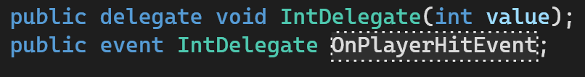
Events & Delegates (5)
EVENTS are a specialised delegate that provides encapsulation
Other classes cannot invoke an event. They can only subscribe or unsubscribe to it.
For the attack system you could use a normal delegate. For the Hit scenario an event works best.

Slide 19
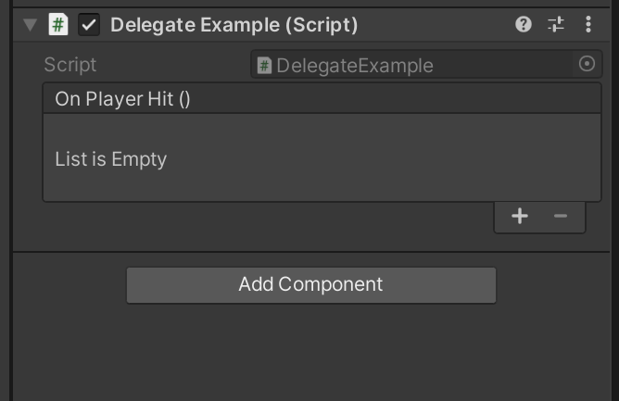

Events & Delegates (6)
UNITY EVENTS are a specialised event designed for Unity
You have already come across them as they are used in all interactions such as button clicks.
They are a user-friendly alternative
Remember to include UnityEngine.Events
Notes:
demonstrate

Slide 20
03
namespaces

Slide 21
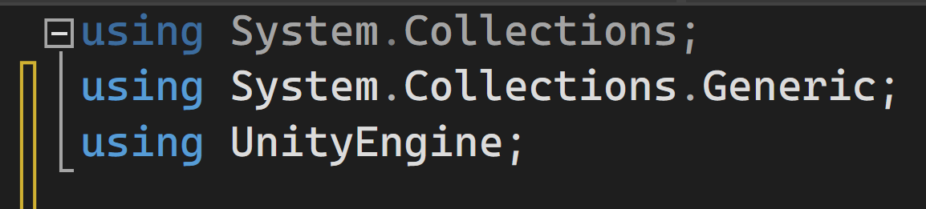
Namespaces (1)
Namespaces are a way to group related types.
They help in organizing code and avoiding naming collisions.
Imagine namespaces as folders in a file system, where each folder (namespace) contains related files (classes, structs, etc.).

Slide 22
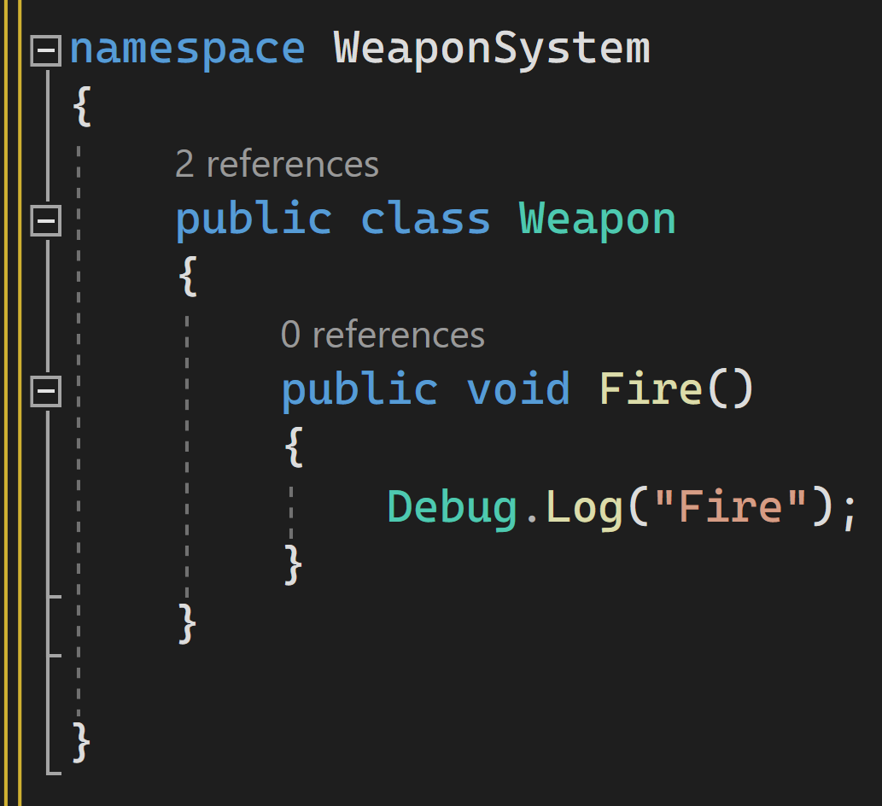
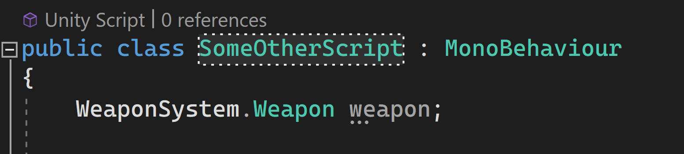
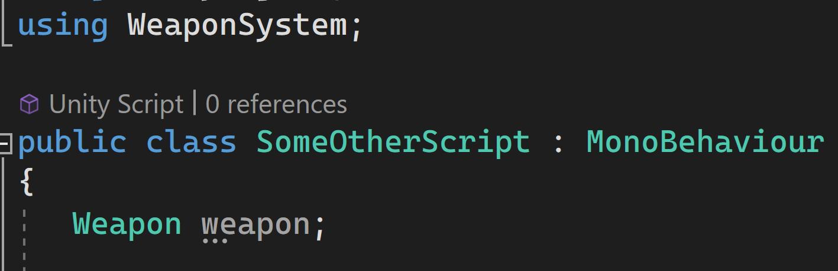
Namespaces (2)

Slide 23
04
Coroutines

Slide 24
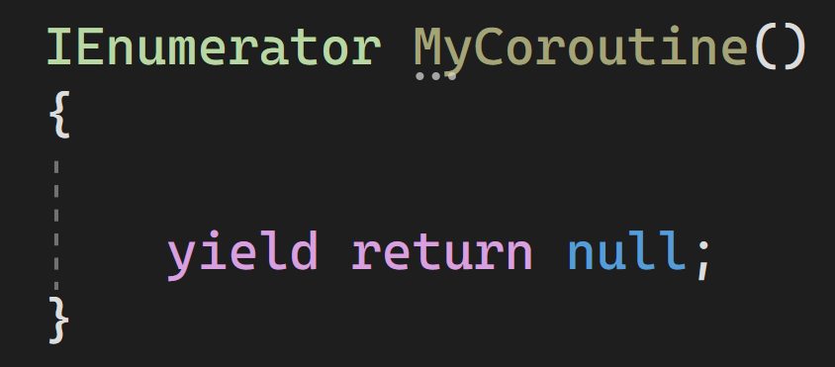
Coroutines(1)
Coroutines are a special type of functions in Unity.
Allow pausing and resuming execution over frames.
Useful for creating sequences, delays, or "waiting" effects without freezing the game.

Slide 25
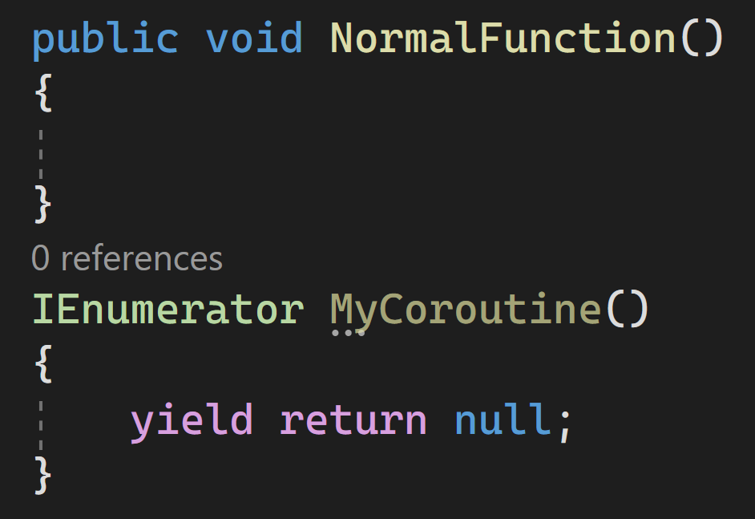
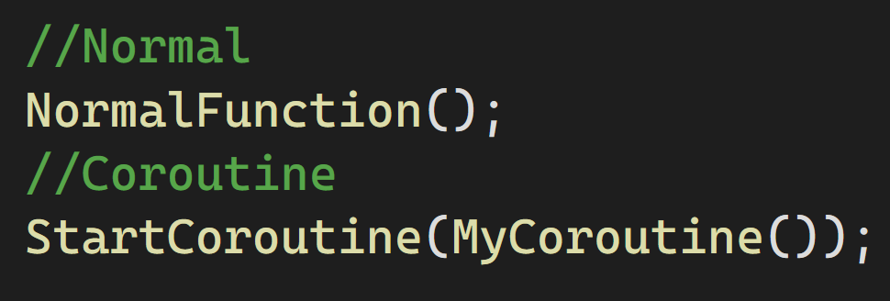
Coroutines(1)
Coroutines are a special type of functions in Unity.
Allow pausing and resuming execution over frames.
Useful for creating delays without freezing the game.

Slide 26
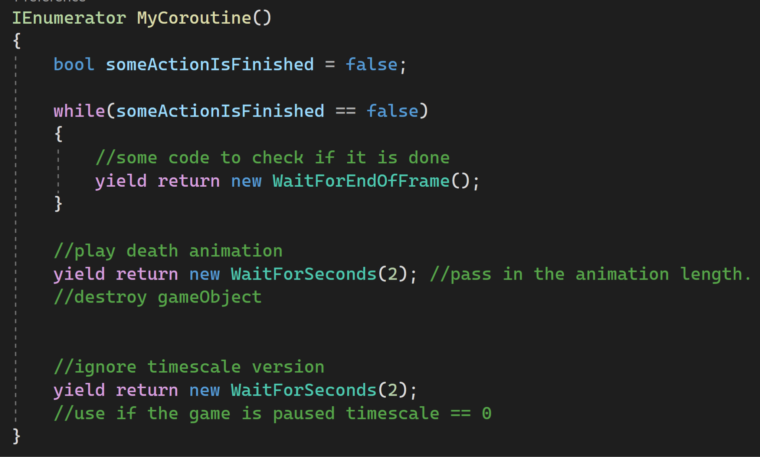
Coroutines(2)

Slide 27
05
Debugging

Slide 28
Thanks!

